Slide 1
DSWE comparison figures
Monthly inundation record.
Landsat and sentinel visual comparison
Comparison to previous multiyear records
Annual inundation extent timeseries
IL and DSWE
Seasonality
Comparison to other climate records
Comparison to GRACE, water tower precipitation, delta precip

Slide 2
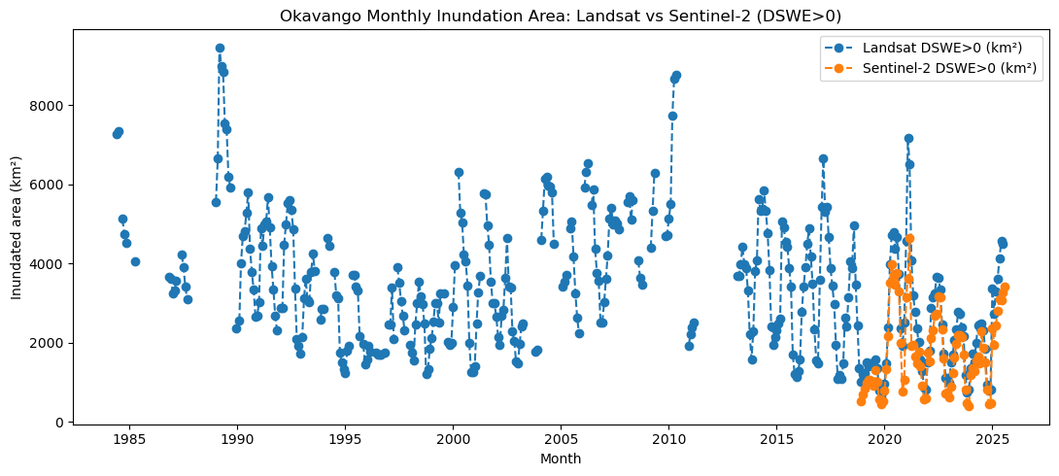

Slide 3
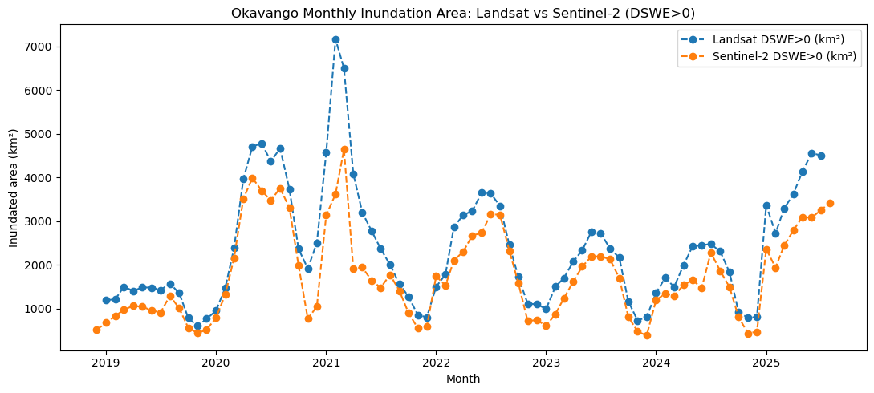

Slide 4
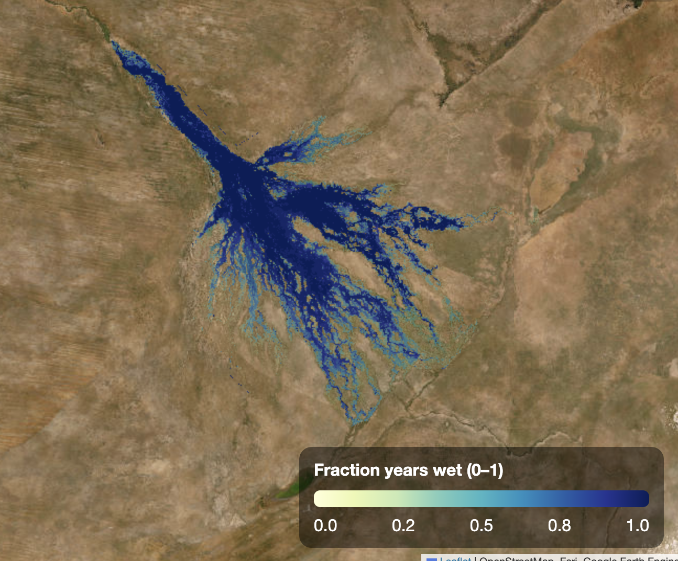
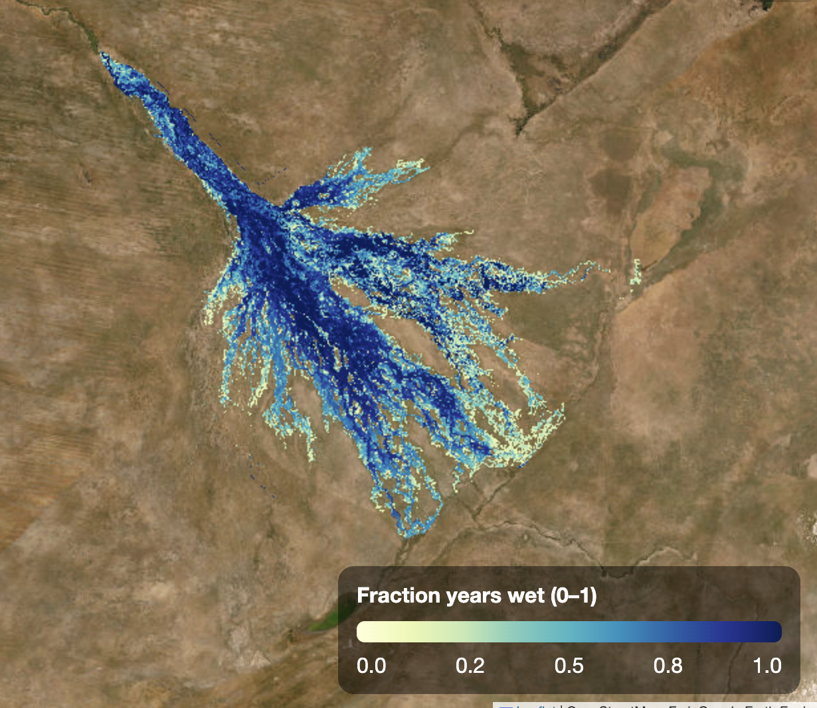
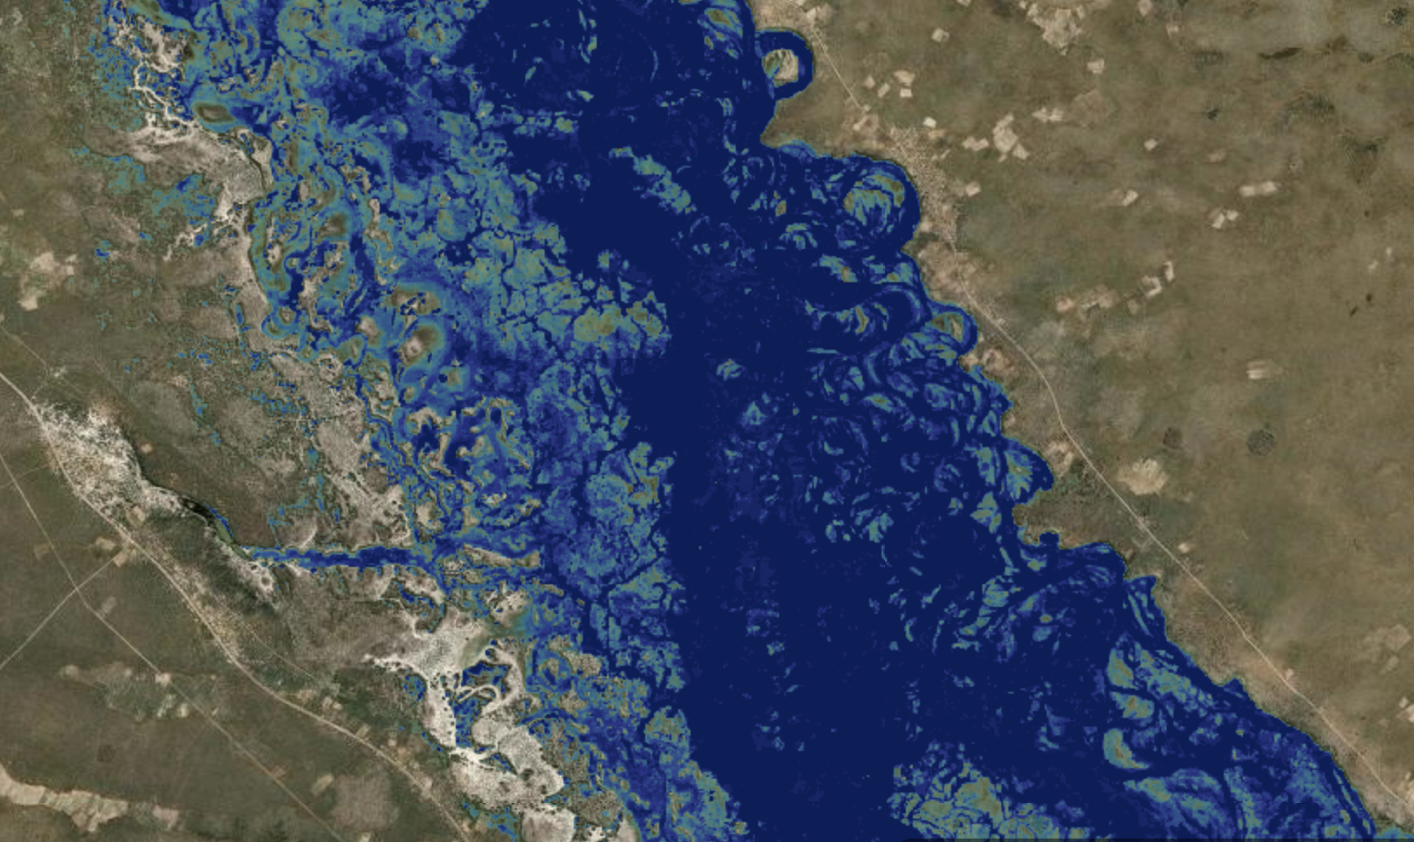
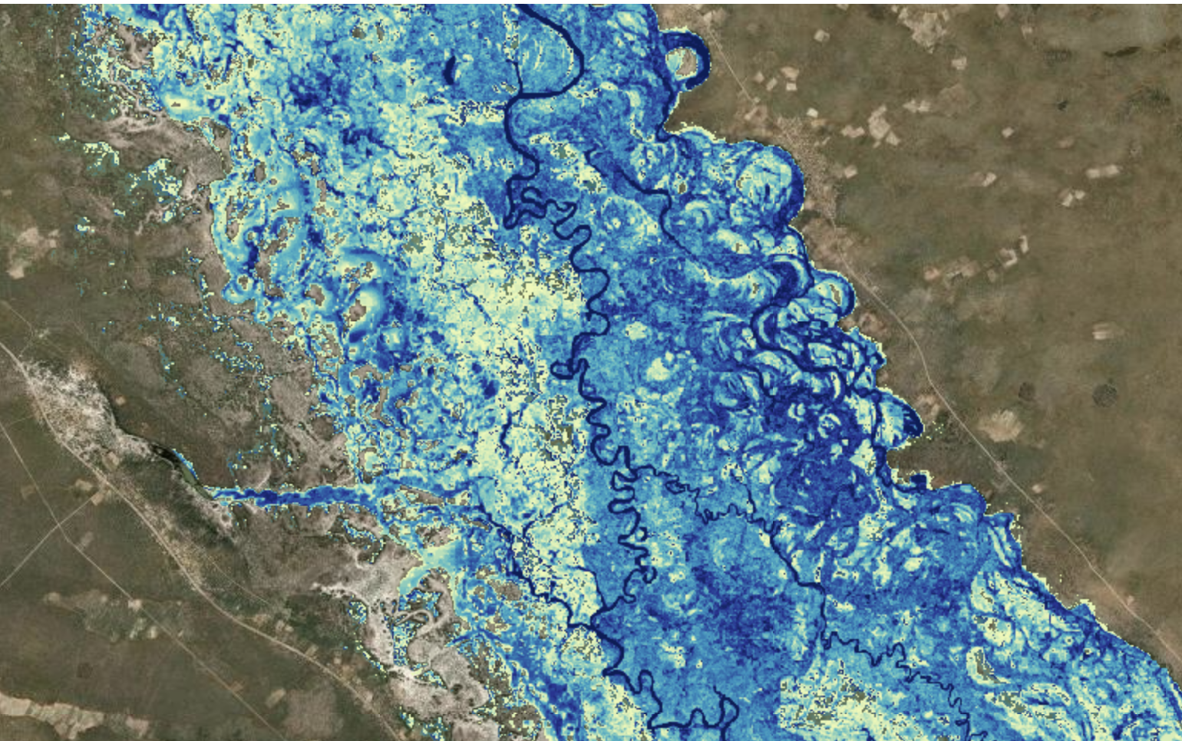
Fraction years inundated in July, August, September
Inserts in periphery and panhandle

Slide 5
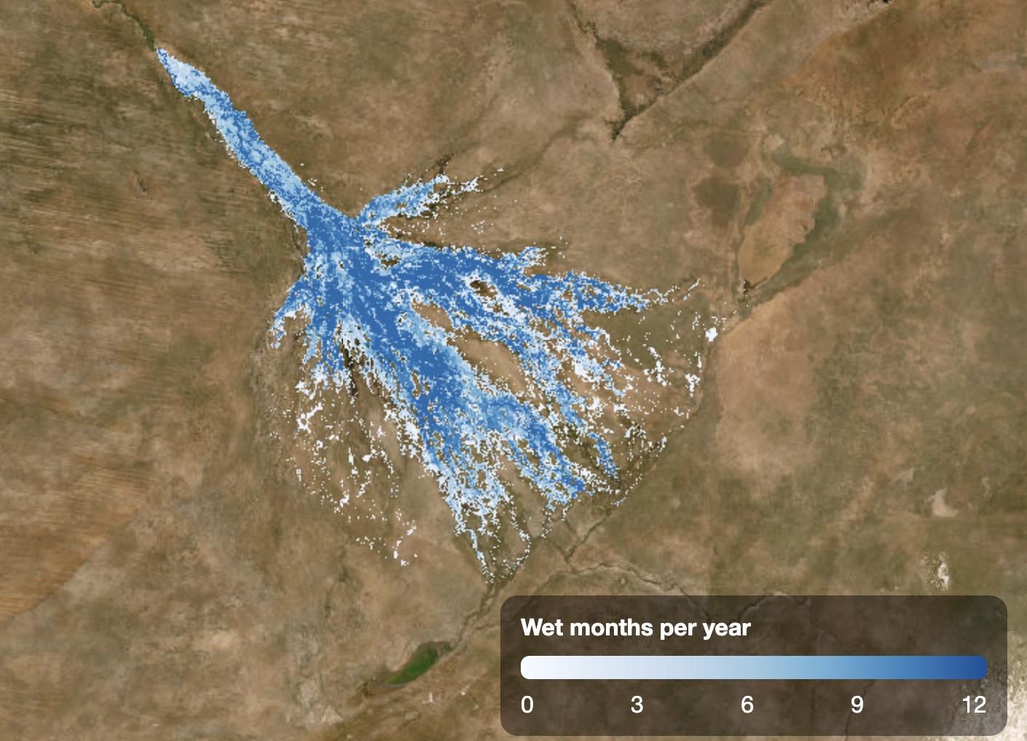

Slide 6
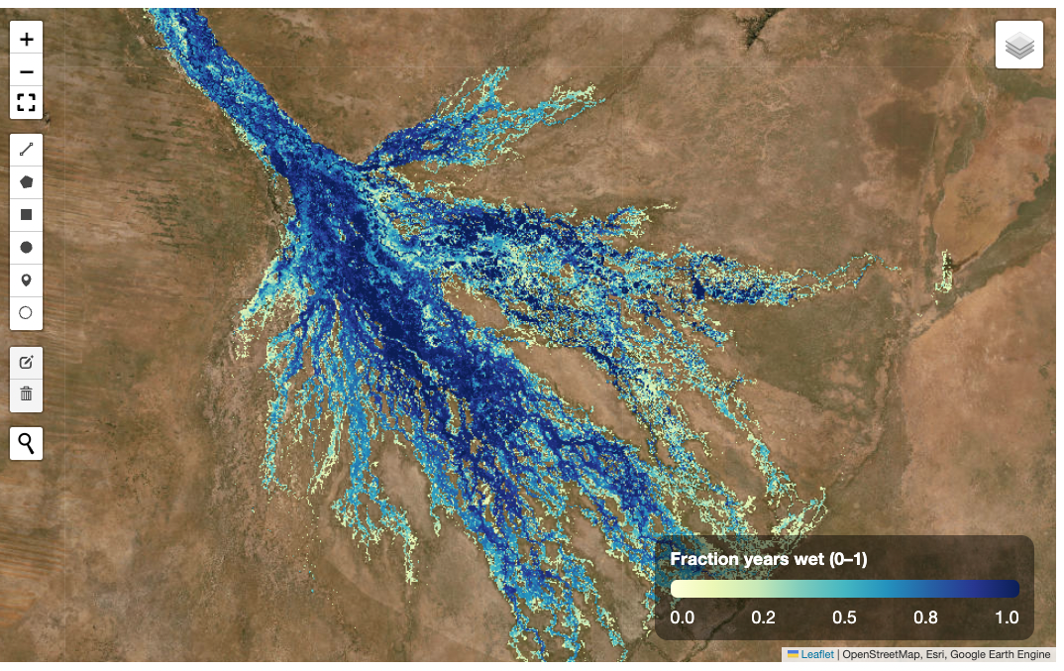

Slide 7
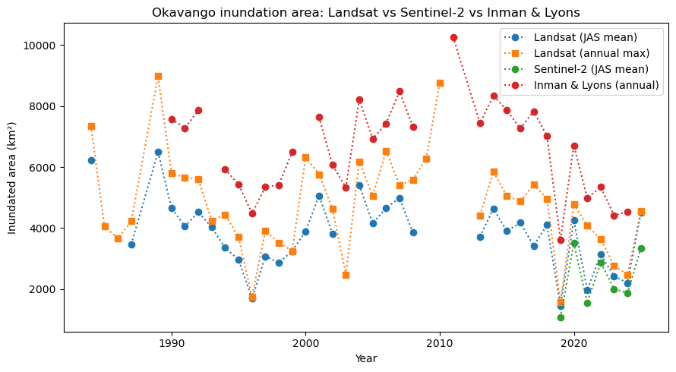

Slide 8
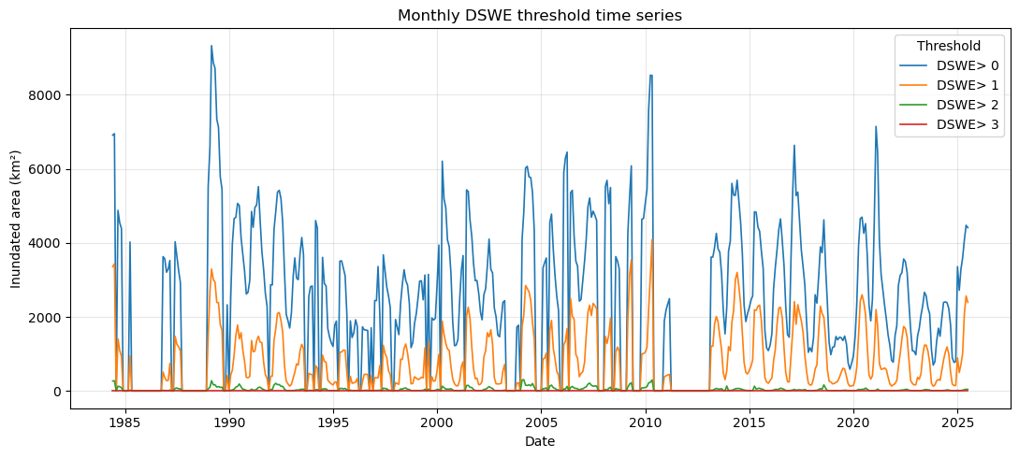

Slide 9
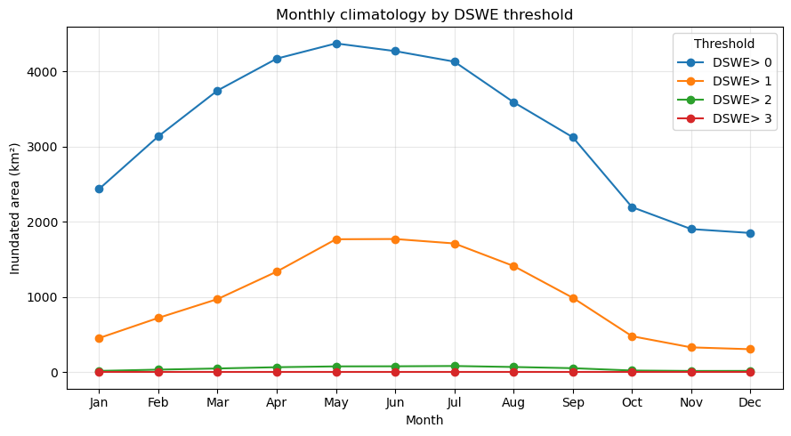

Slide 10
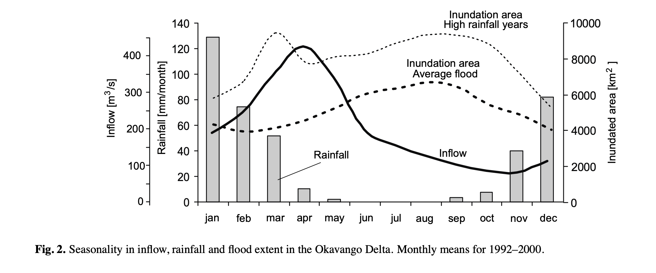

Slide 11
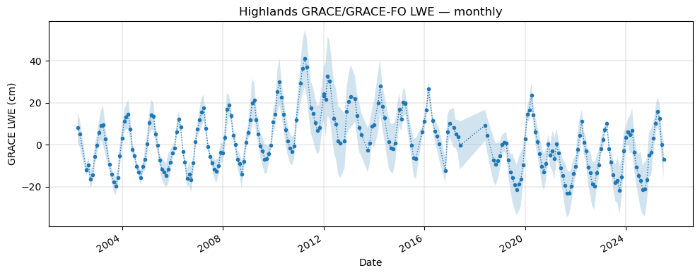
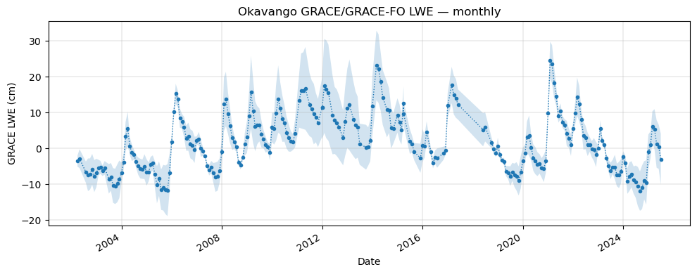

Slide 12
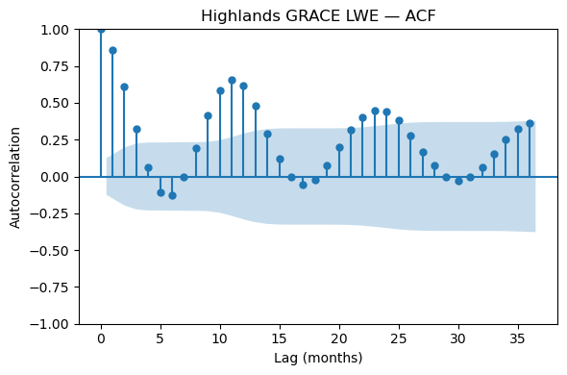
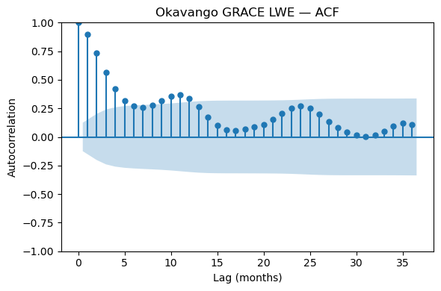

Slide 13
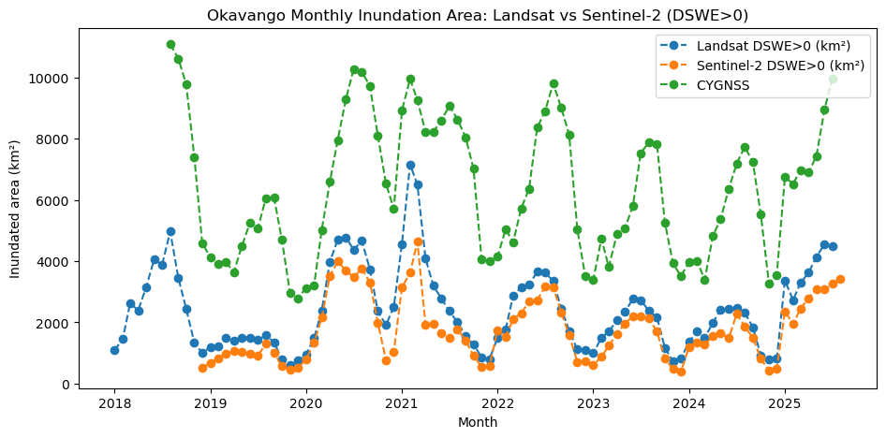

Slide 14
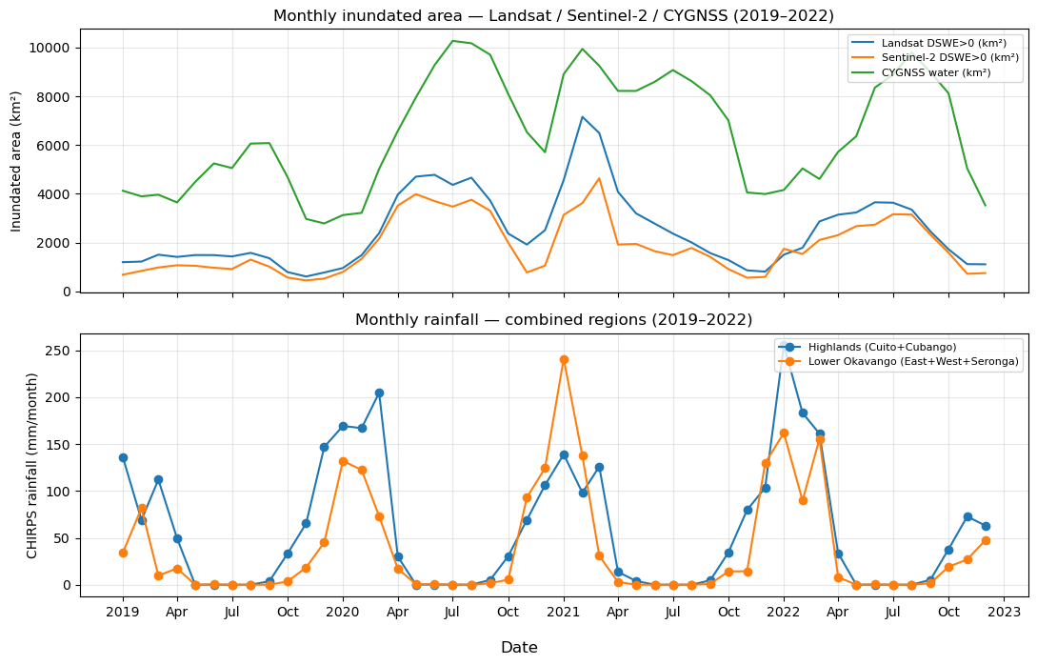

Slide 15
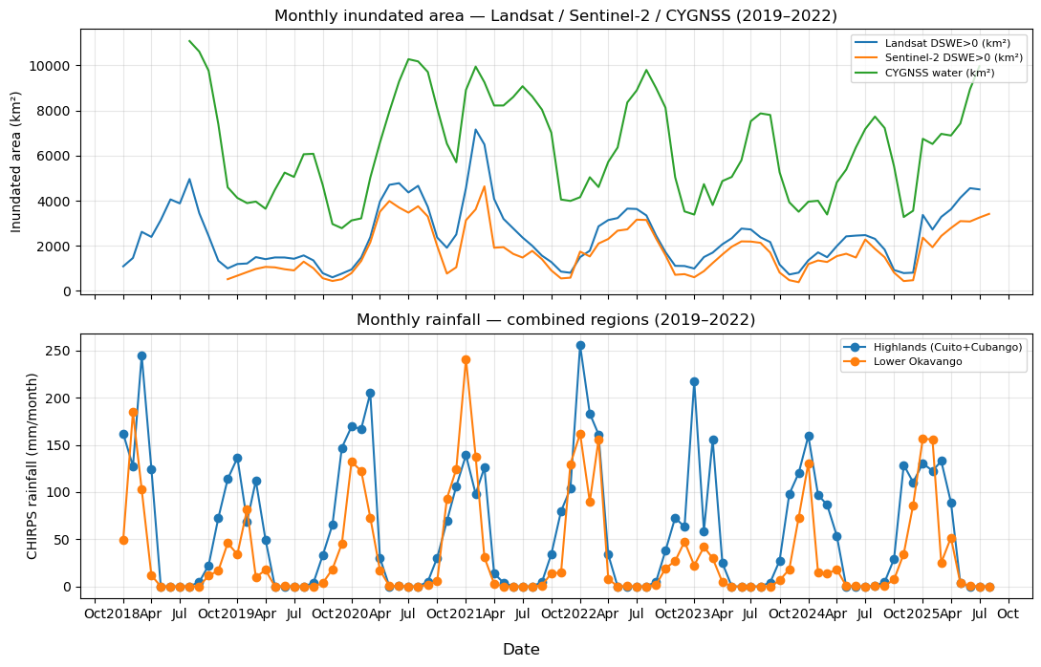

Slide 16
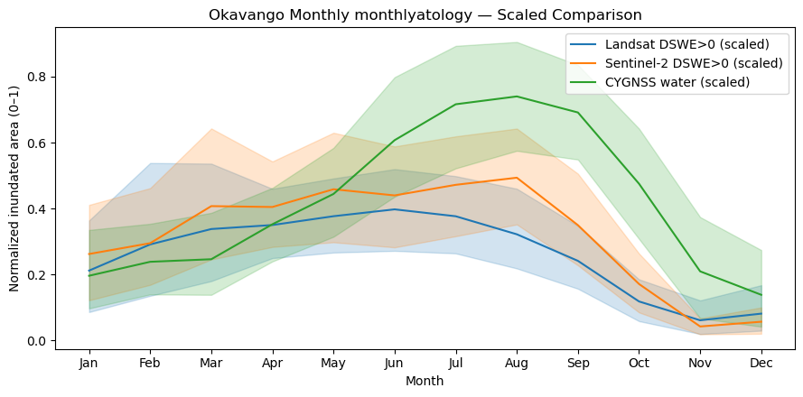
Why does CYNSS show a later peak than DSWE in surface water extent?

Slide 17
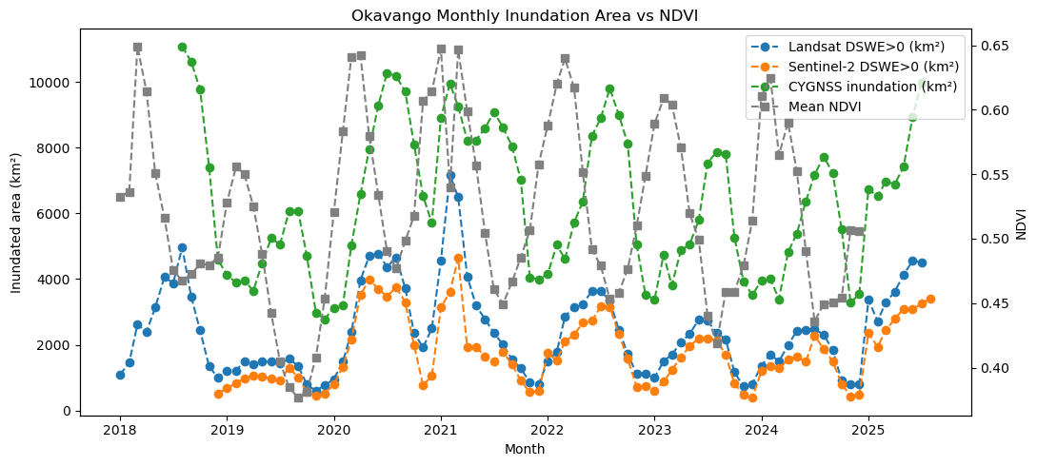

Slide 18
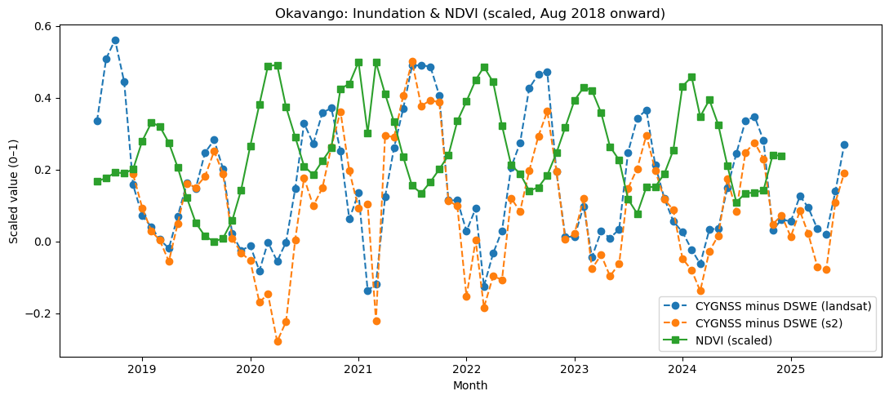

Slide 19
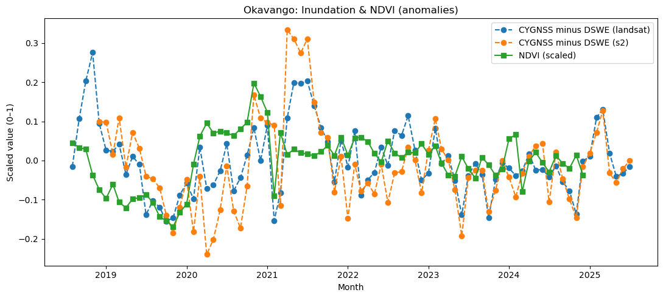

Slide 20
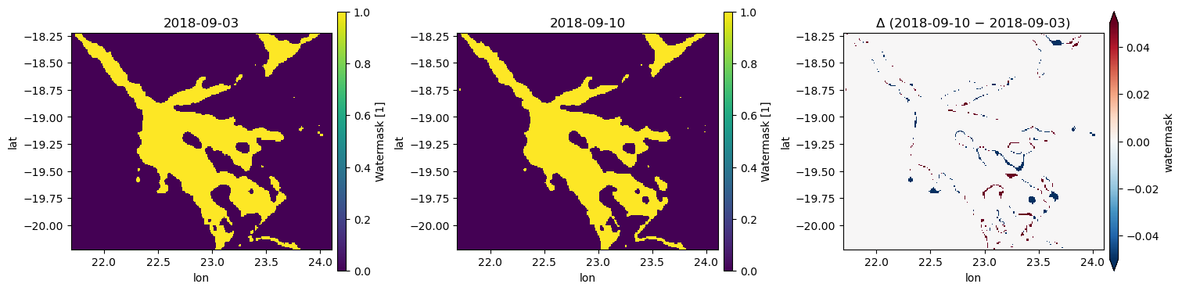

Slide 21
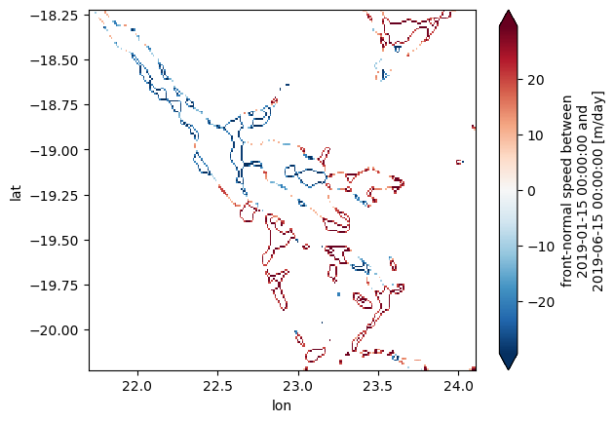

Slide 23
Oscillation time period (what “multi-decadal” means here)
They describe persistent wet/dry phases on multi-decadal (≈30+ year) time scales in Okavango flows. (ScienceDirect)
Prior Fourier analyses they cite found ~60–80-year quasi-periodicity (the main band they focus on), plus ~16–18-year and ~3–8-year variability. (ScienceDirect)
Likely sources of the oscillations (what drives them)
Immediate driver: multi-decadal variability in rainfall, with the paper emphasizing that a relatively weak rainfall signal can be amplified by catchment processes into stronger multi-decadal swings in river flow and delta wetting/drying. (ScienceDirect)
Underlying source: they argue the rainfall oscillations are most consistent with internal climate-system variability (not external natural/anthropogenic forcing), while noting possible links to large-scale SST/pressure modes (e.g., PDO/NAO/AMO) but without pinning down a single mechanism. (ScienceDirect)
Climate change overlay: 21st-century projections show a warming-driven shift toward drier conditions, with multi-decadal oscillations still likely to occur and sometimes offset/amplify the drying trend. (ScienceDirect)
Wolski et al. attribute the Okavango’s ~30–80-year wet/dry phases mainly to rainfall-driven internal climate variability (amplified by catchment hydrology), and project that similar oscillations will likely persist while being superimposed on a warming-driven drying trend this century. (ScienceDirect)

